Slide 1
Preliminary results
Katharine Prata

Slide 5
Basic structure

Slide 6
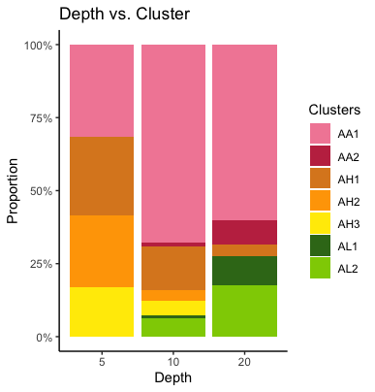
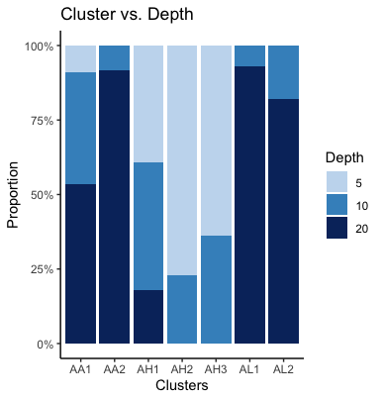

Slide 7
Colony elevation
I.e., angle of elevation

Slide 8
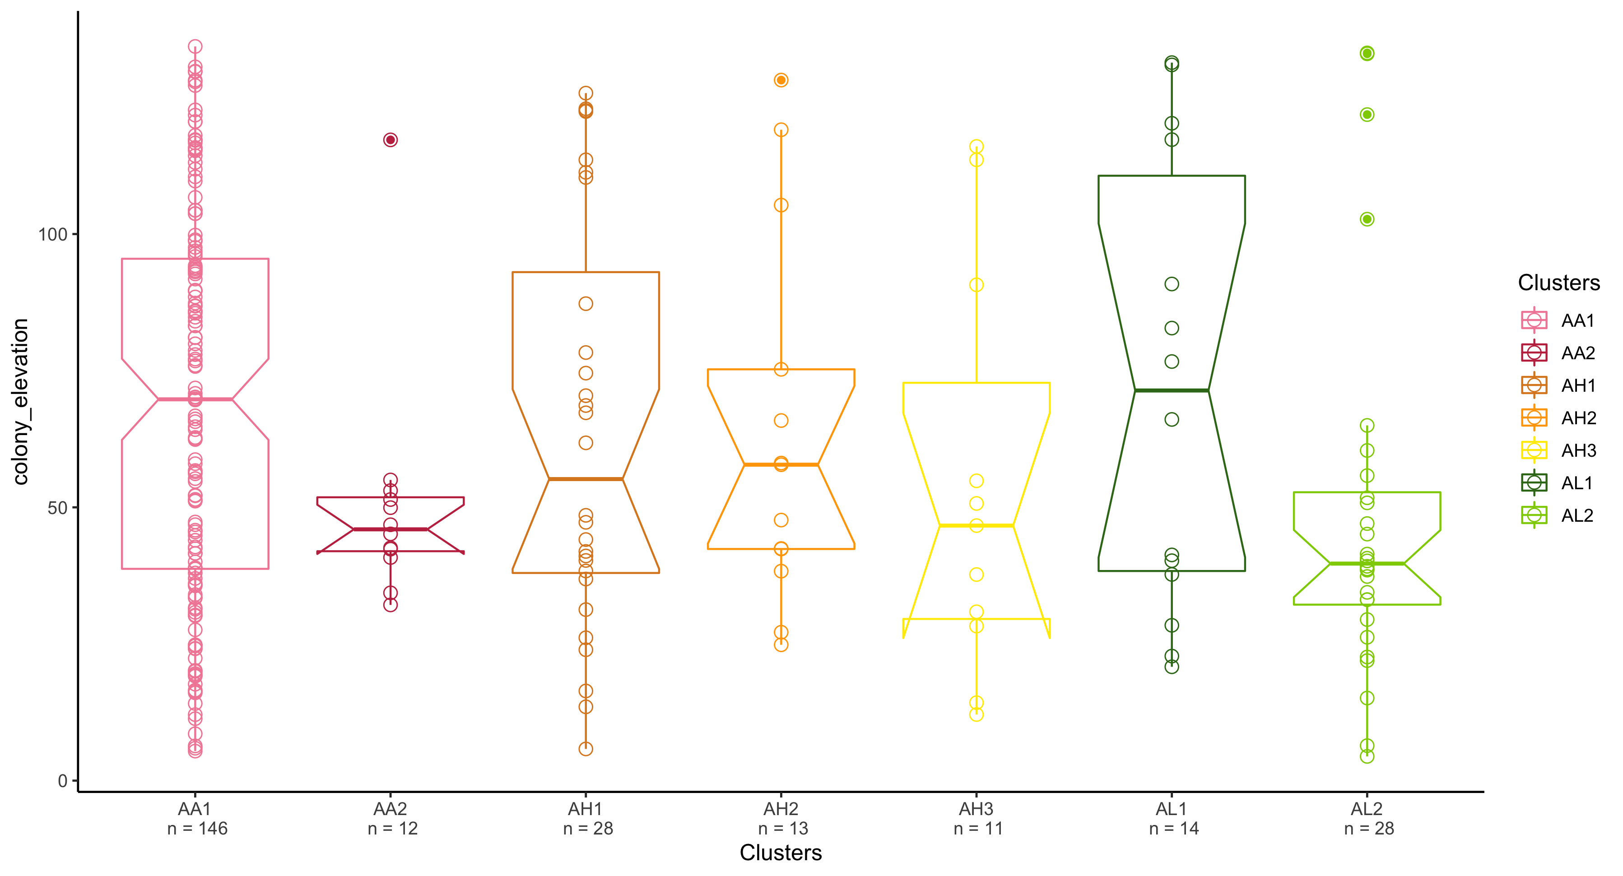

Slide 9
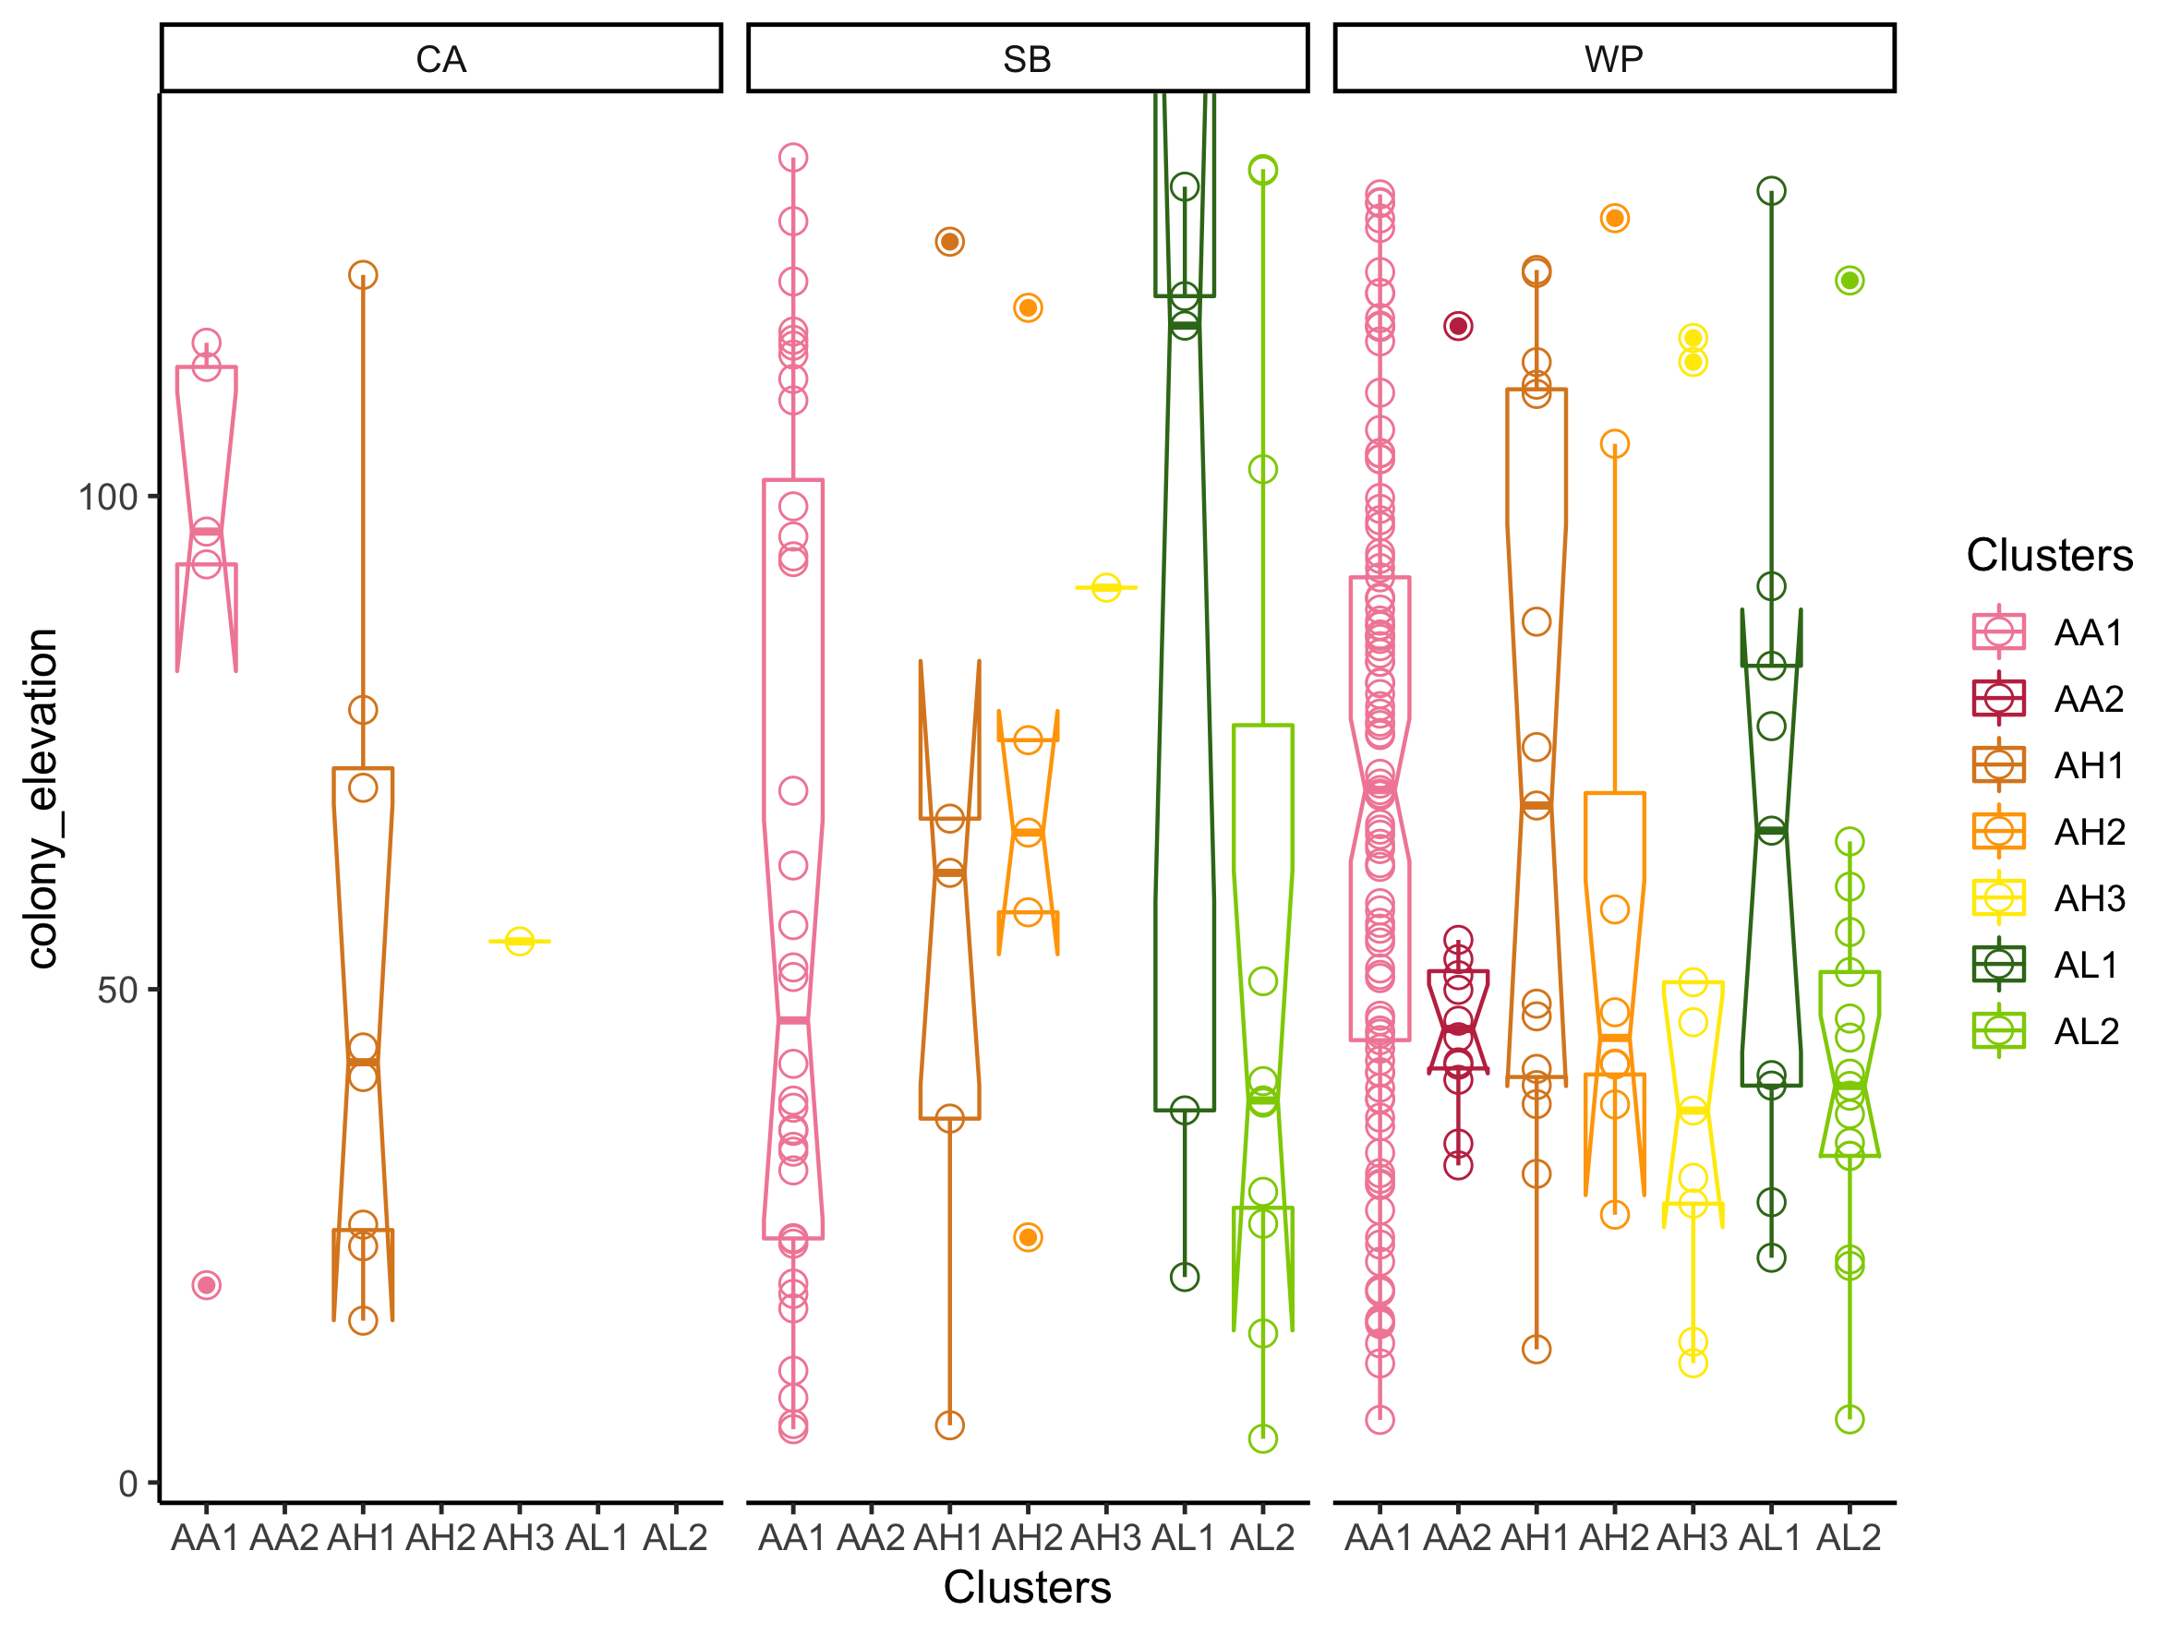
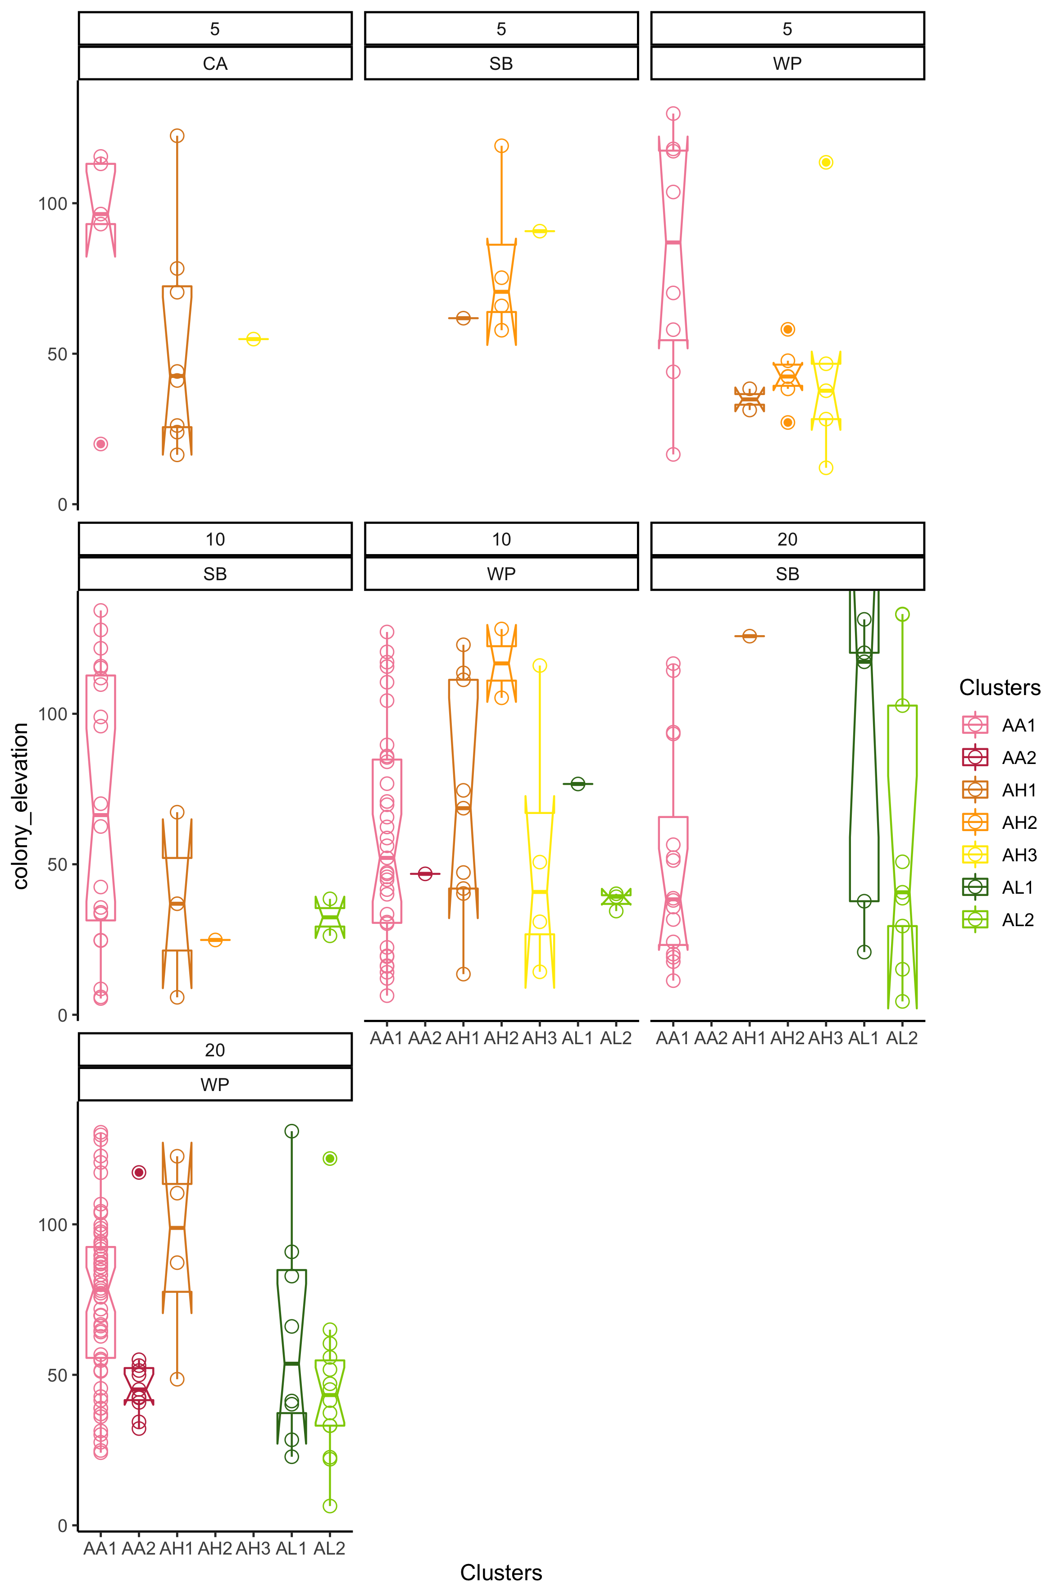
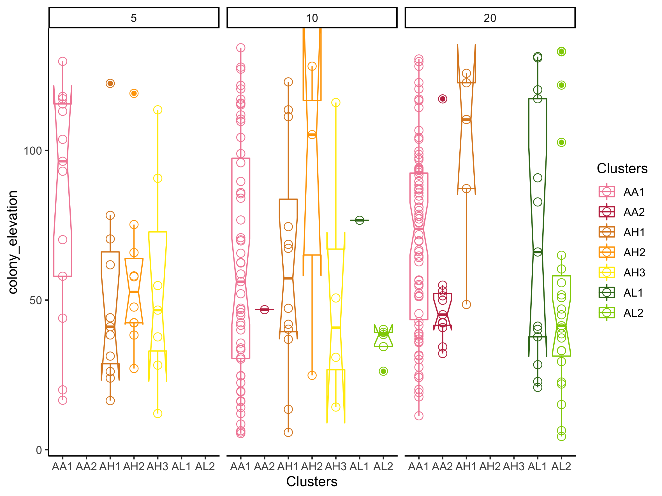

Slide 10
Environment Rugosity

Slide 11
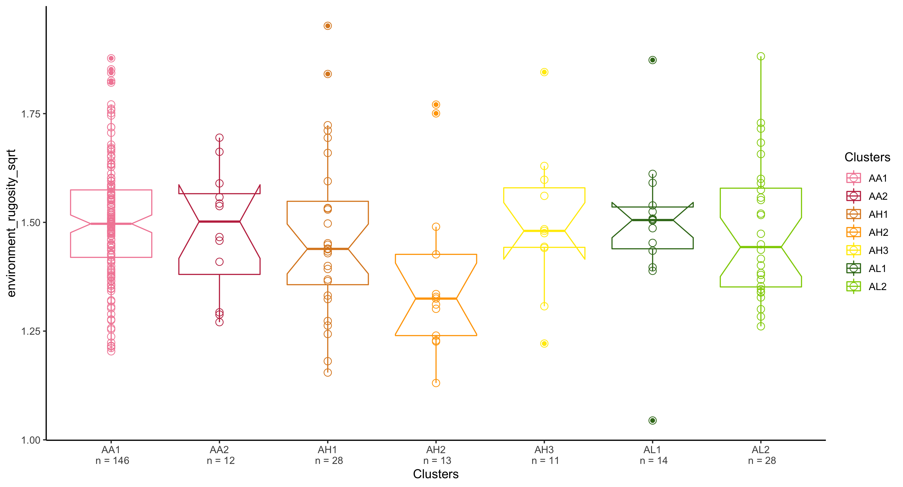

Slide 12
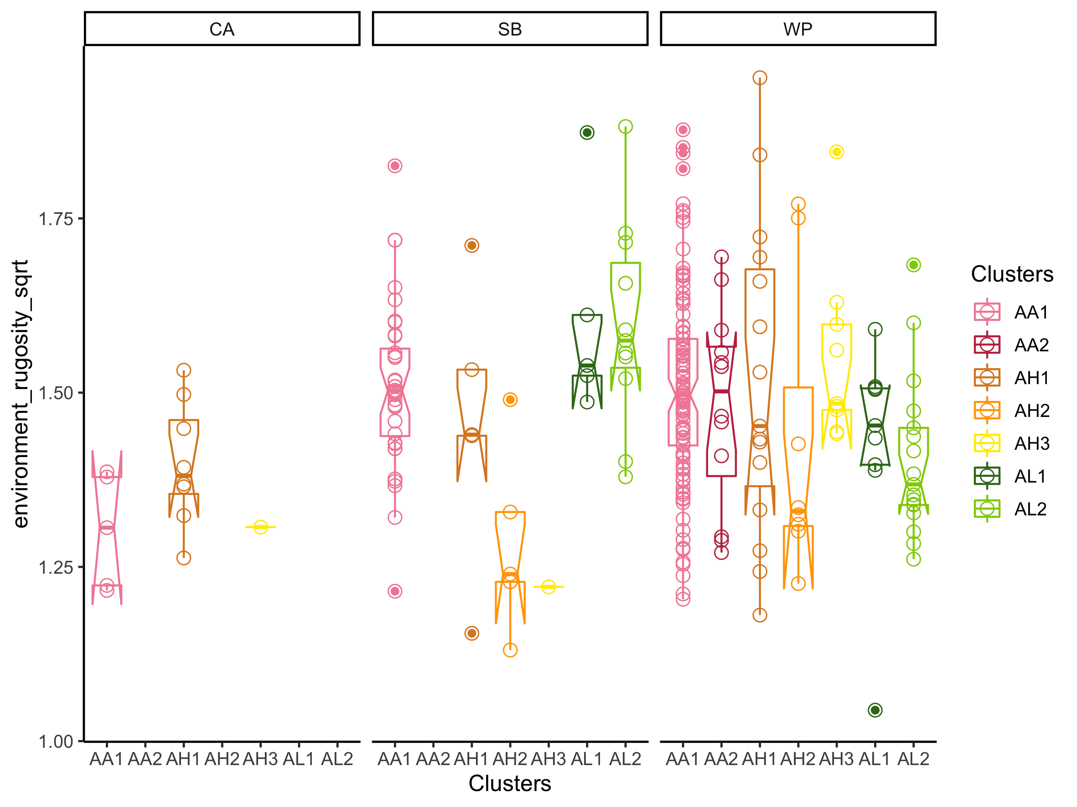
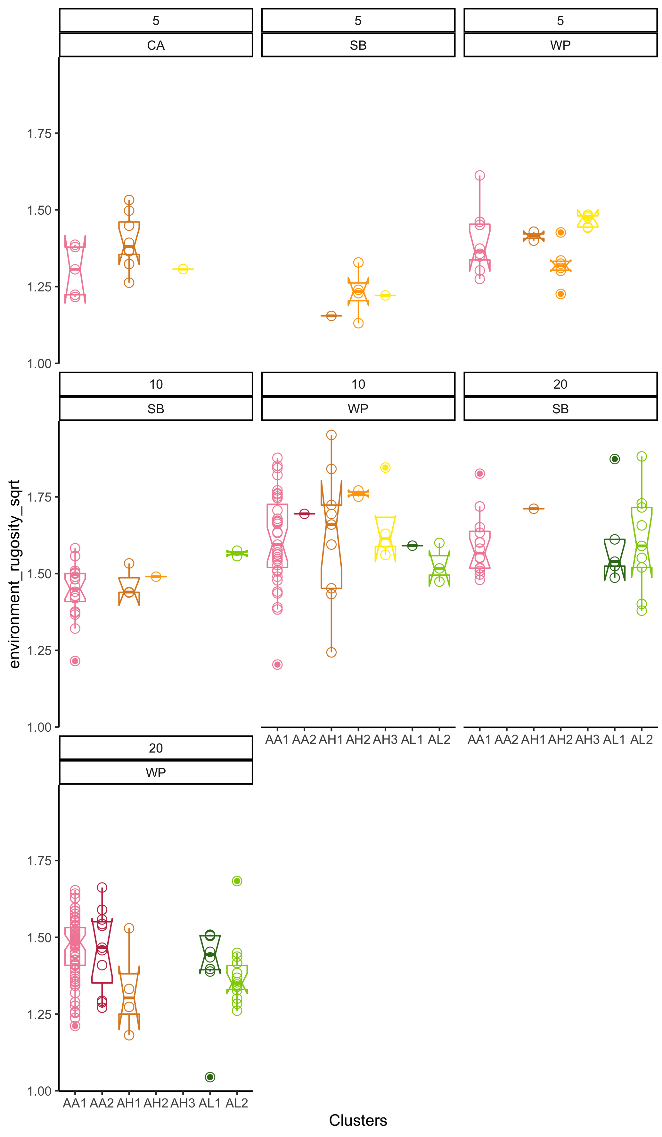
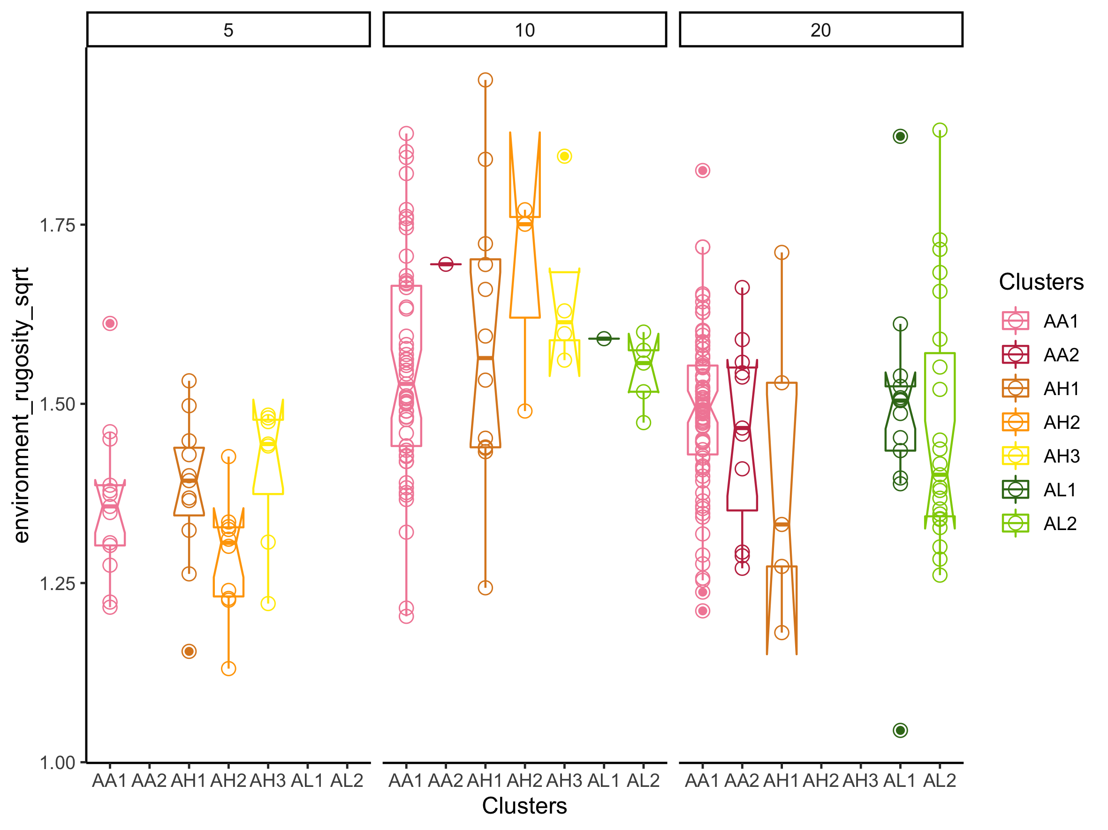

Slide 13
Stats
lmer.environment_rugosity.depth <- lmer(environment_rugosity_sqrt ~ Depth + (1|Loc), data = metadata)
$`pairwise differences of Depth`
1 estimate SE df t.ratio p.value
5 - 10 -0.2111 0.0269 163 -7.837 <.0001
5 - 20 -0.1238 0.0255 137 -4.856 <.0001
10 - 20 0.0873 0.0199 249 4.391 <.0001

Slide 14
Outcrop proportion

Slide 15
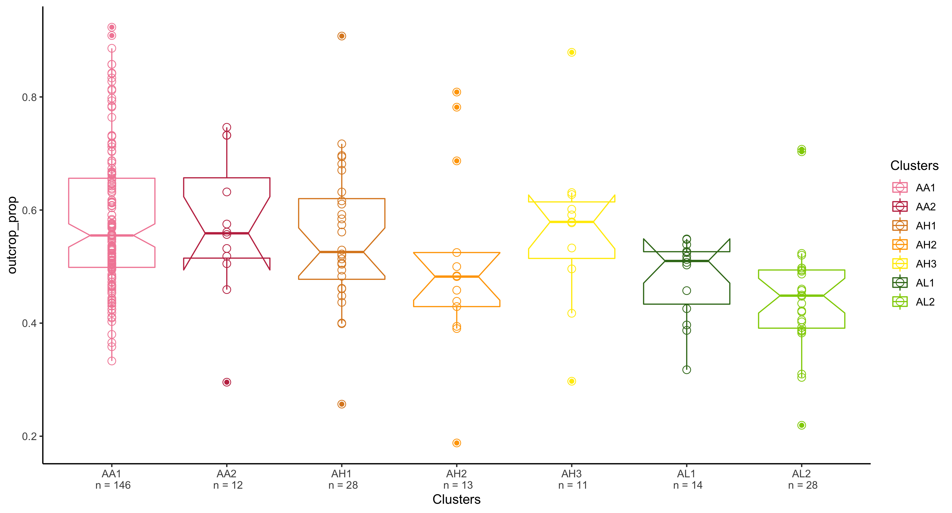

Slide 16
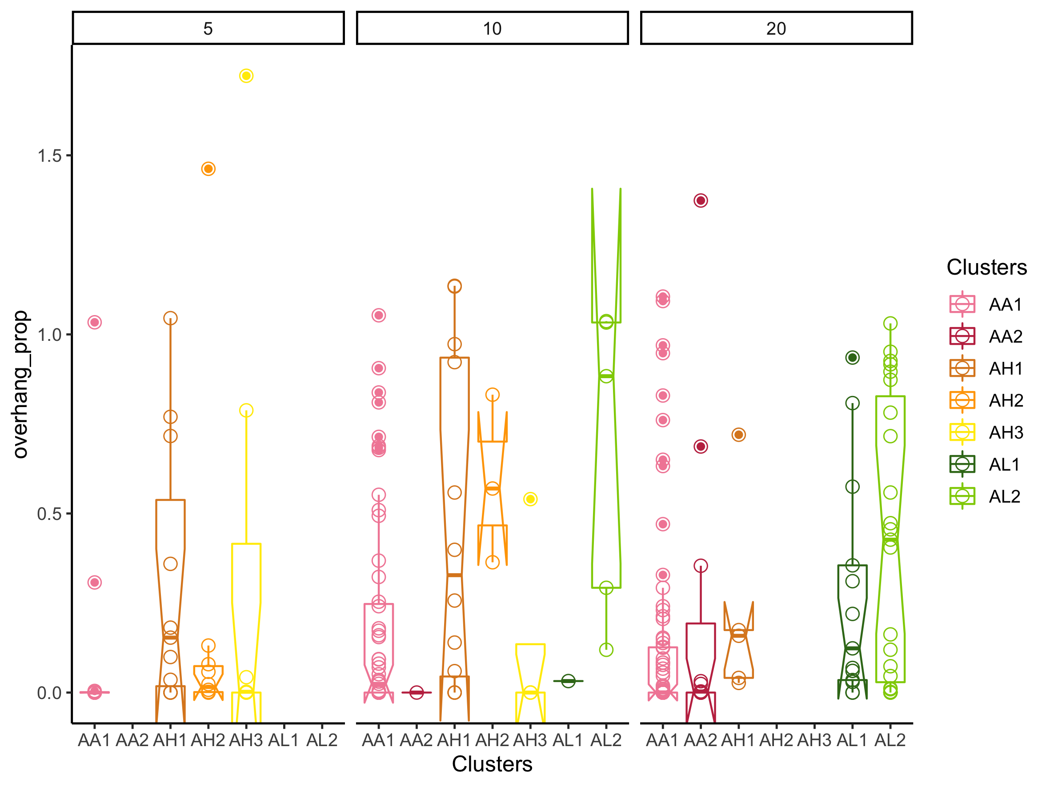
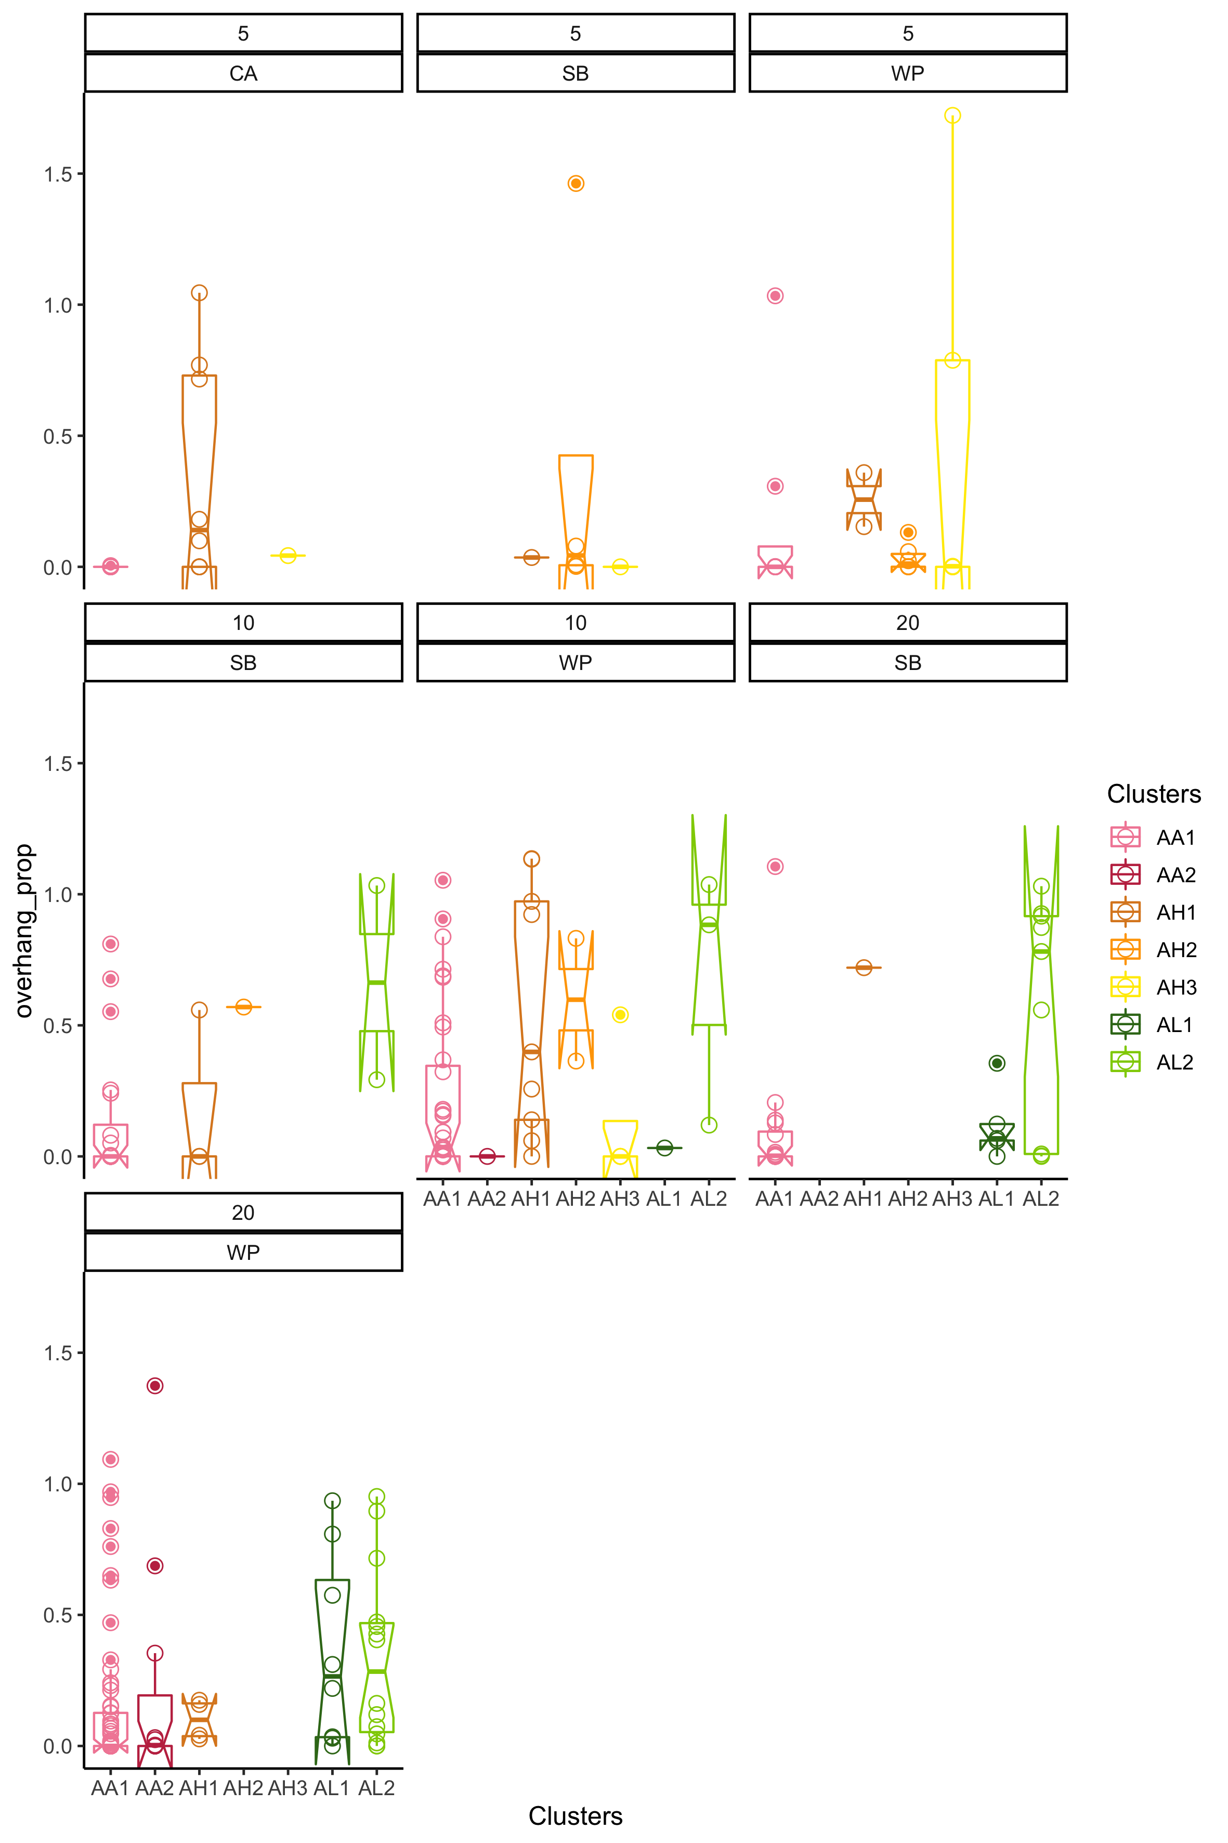
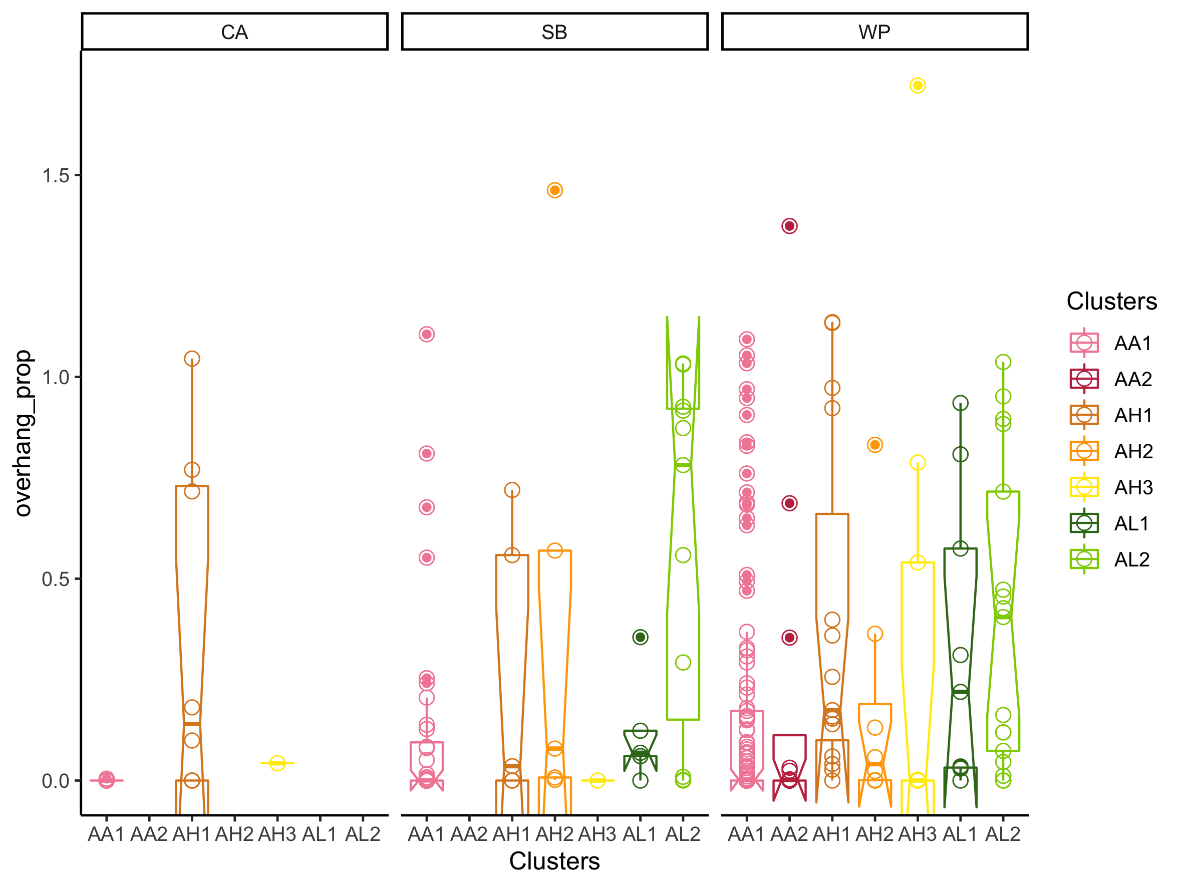

Slide 17
Stats
lmer.outcrop_prop <- lmer(outcrop_prop ~ Clusters + (1|Loc/Depth), data = metadata)
AA1 - AL2 0.13100 0.0263 233 4.980 <.0001

Slide 18
Overhang proportion

Slide 19
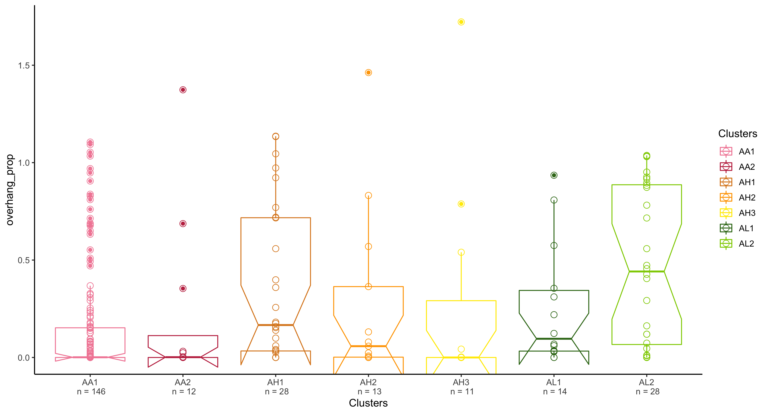

Slide 21
Stats
lmer.overhang <- lmer(overhang_prop ~ Clusters + (1|Loc), data = metadata)
AA1 - AL2 -0.32056 0.0717 244 -4.471 0.0002

Slide 22
Colony rugosity

Slide 23
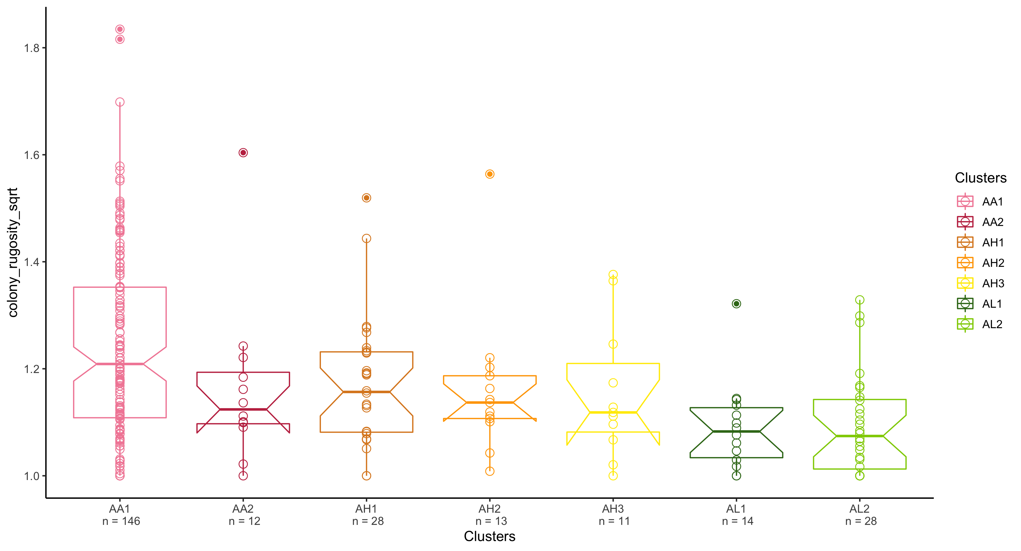

Slide 24
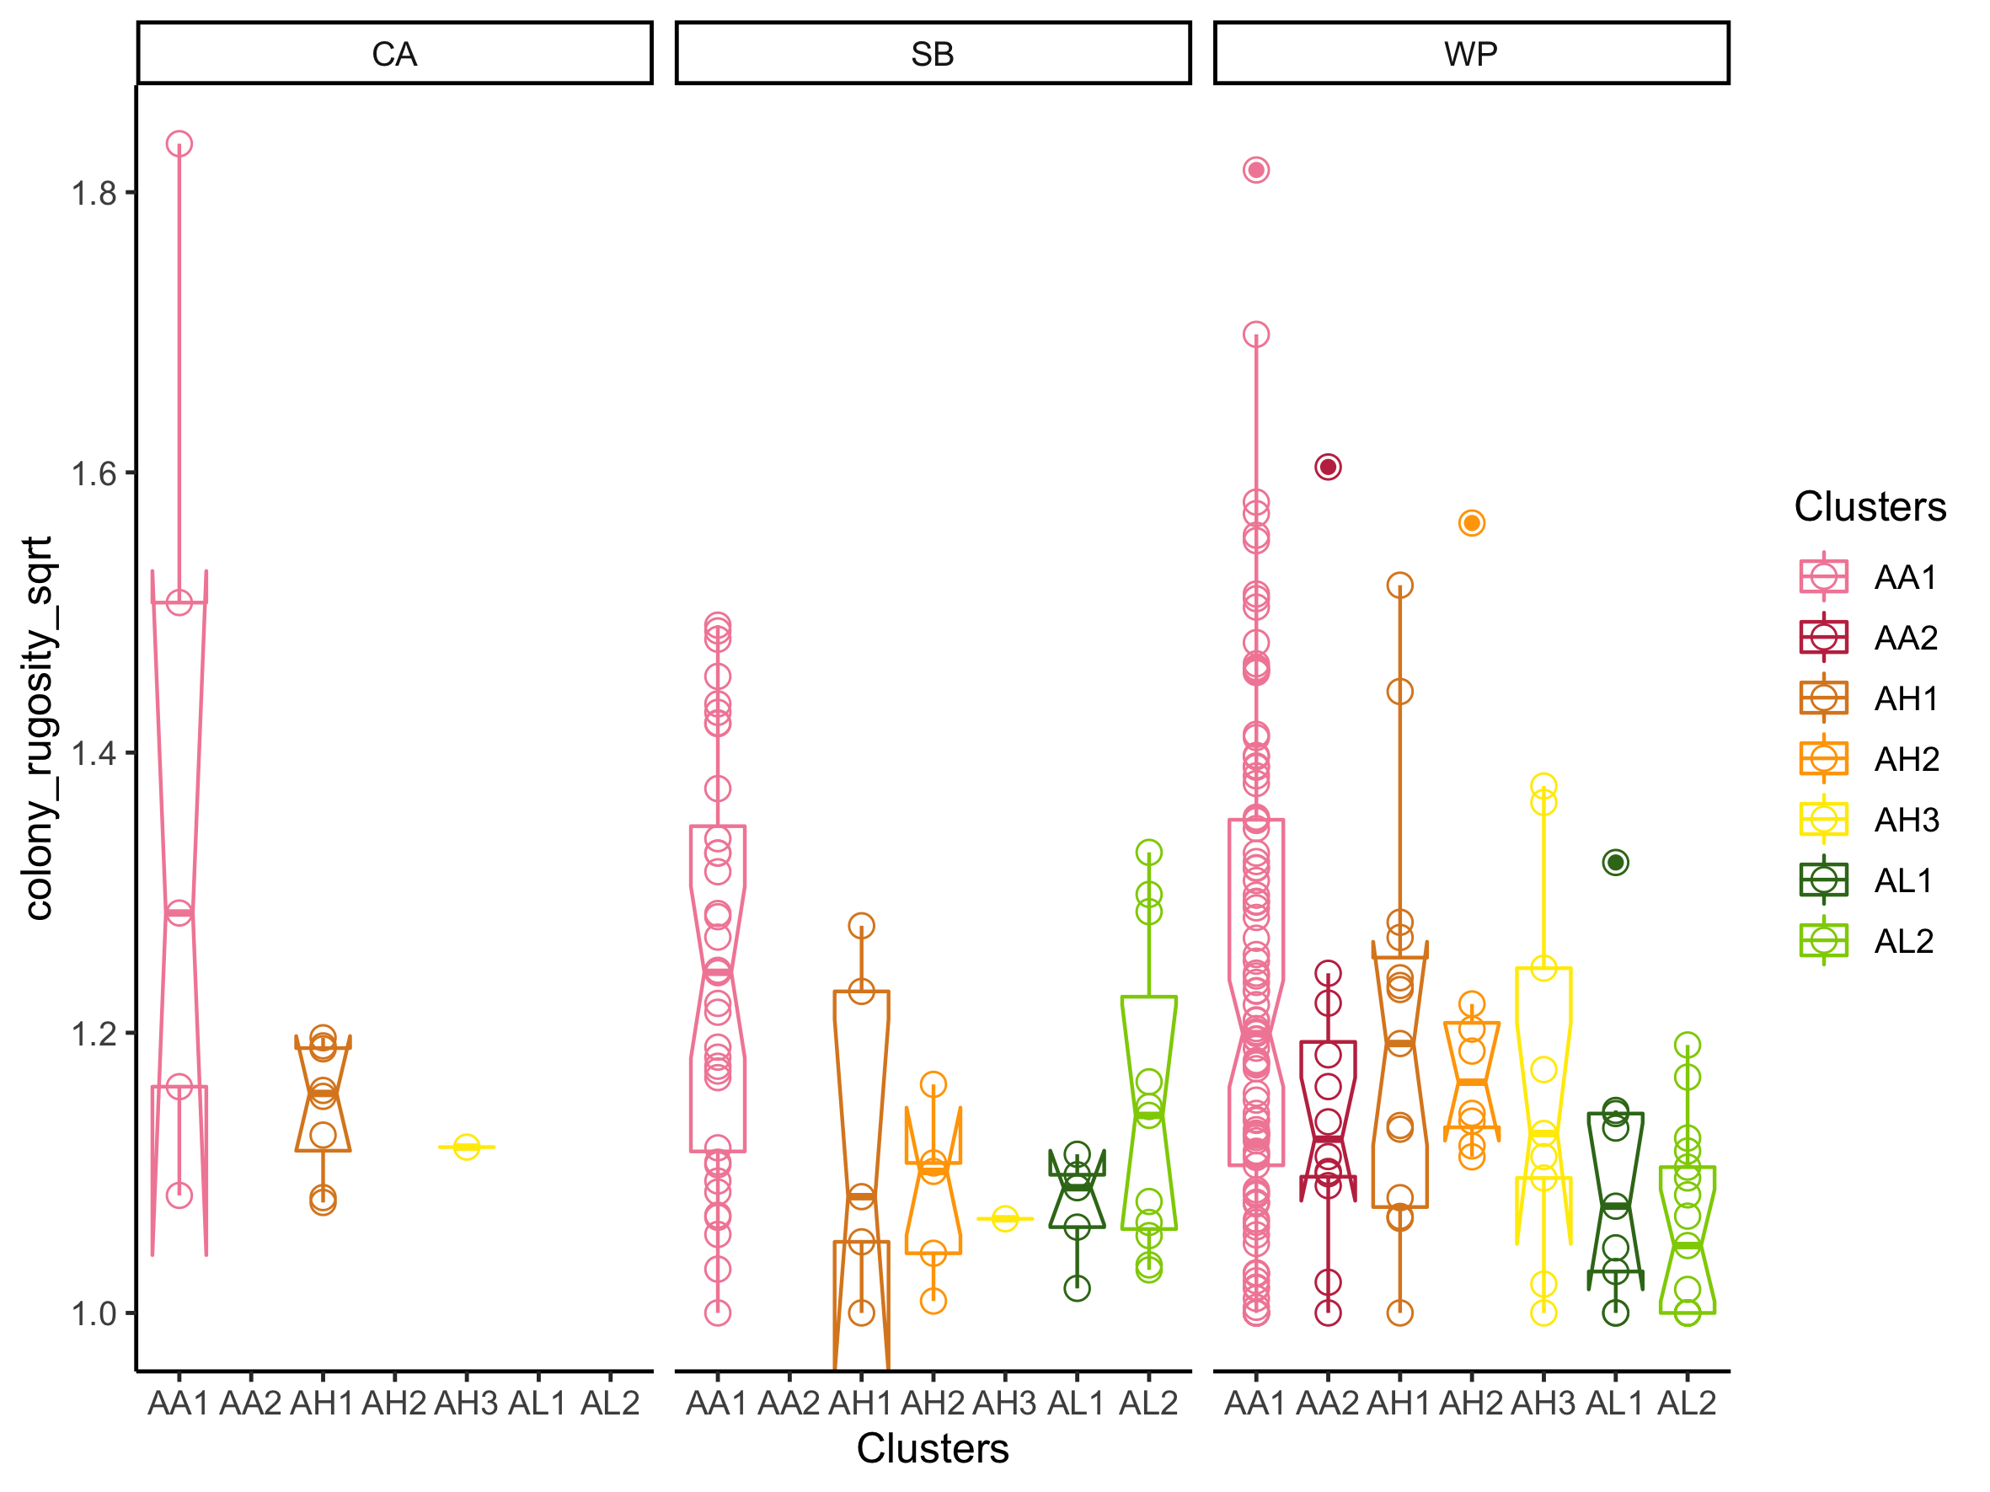
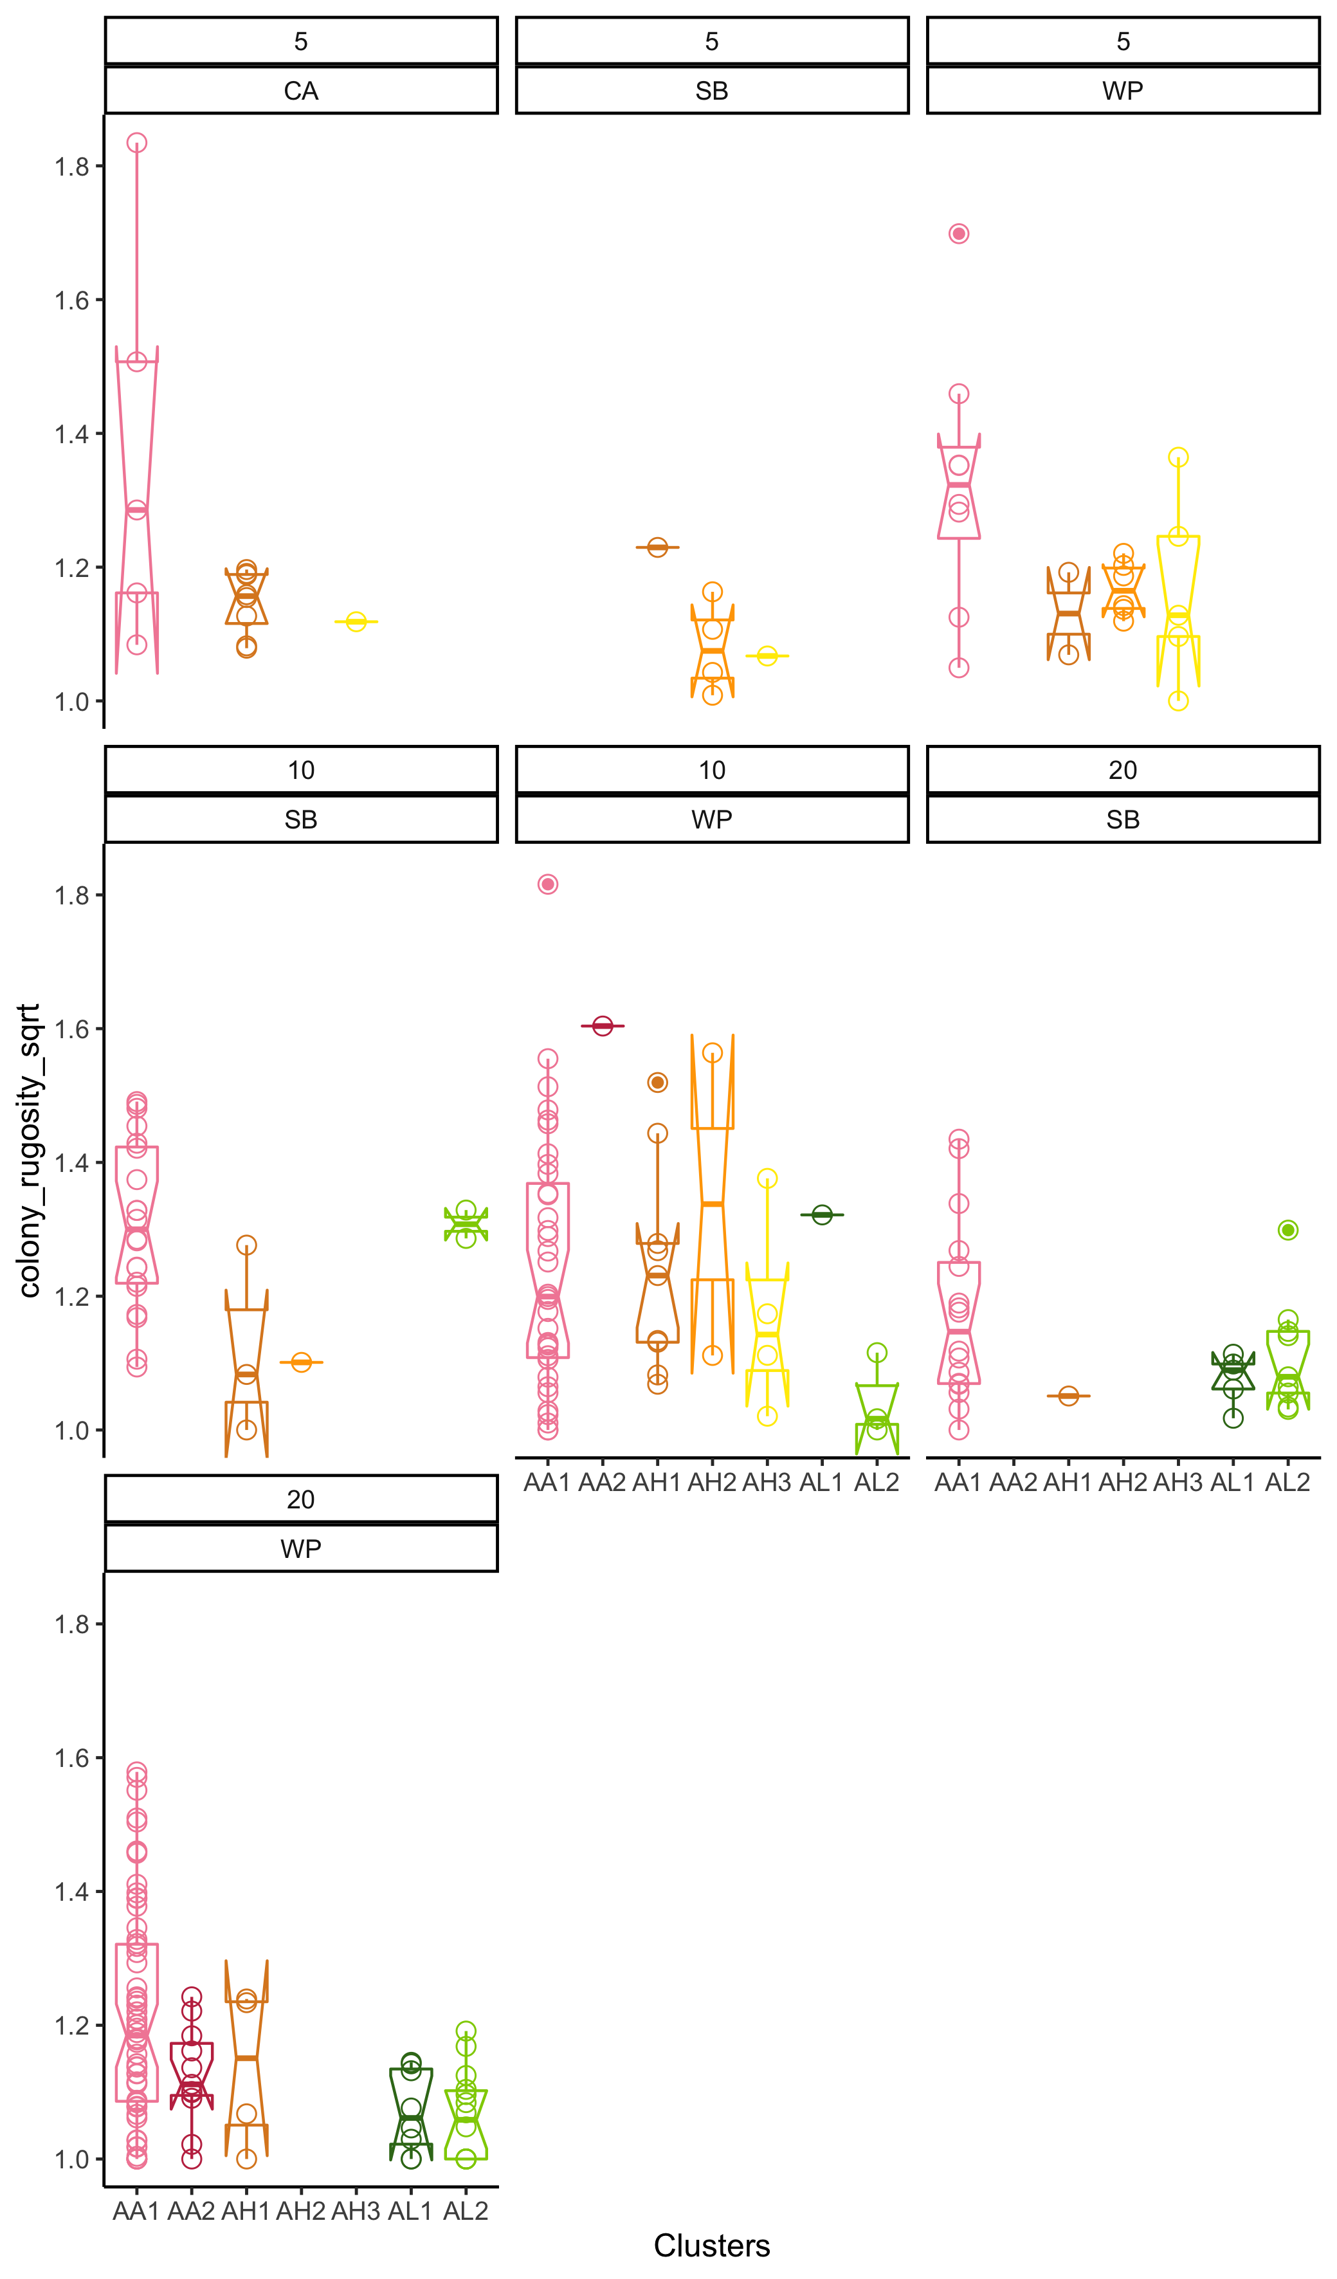
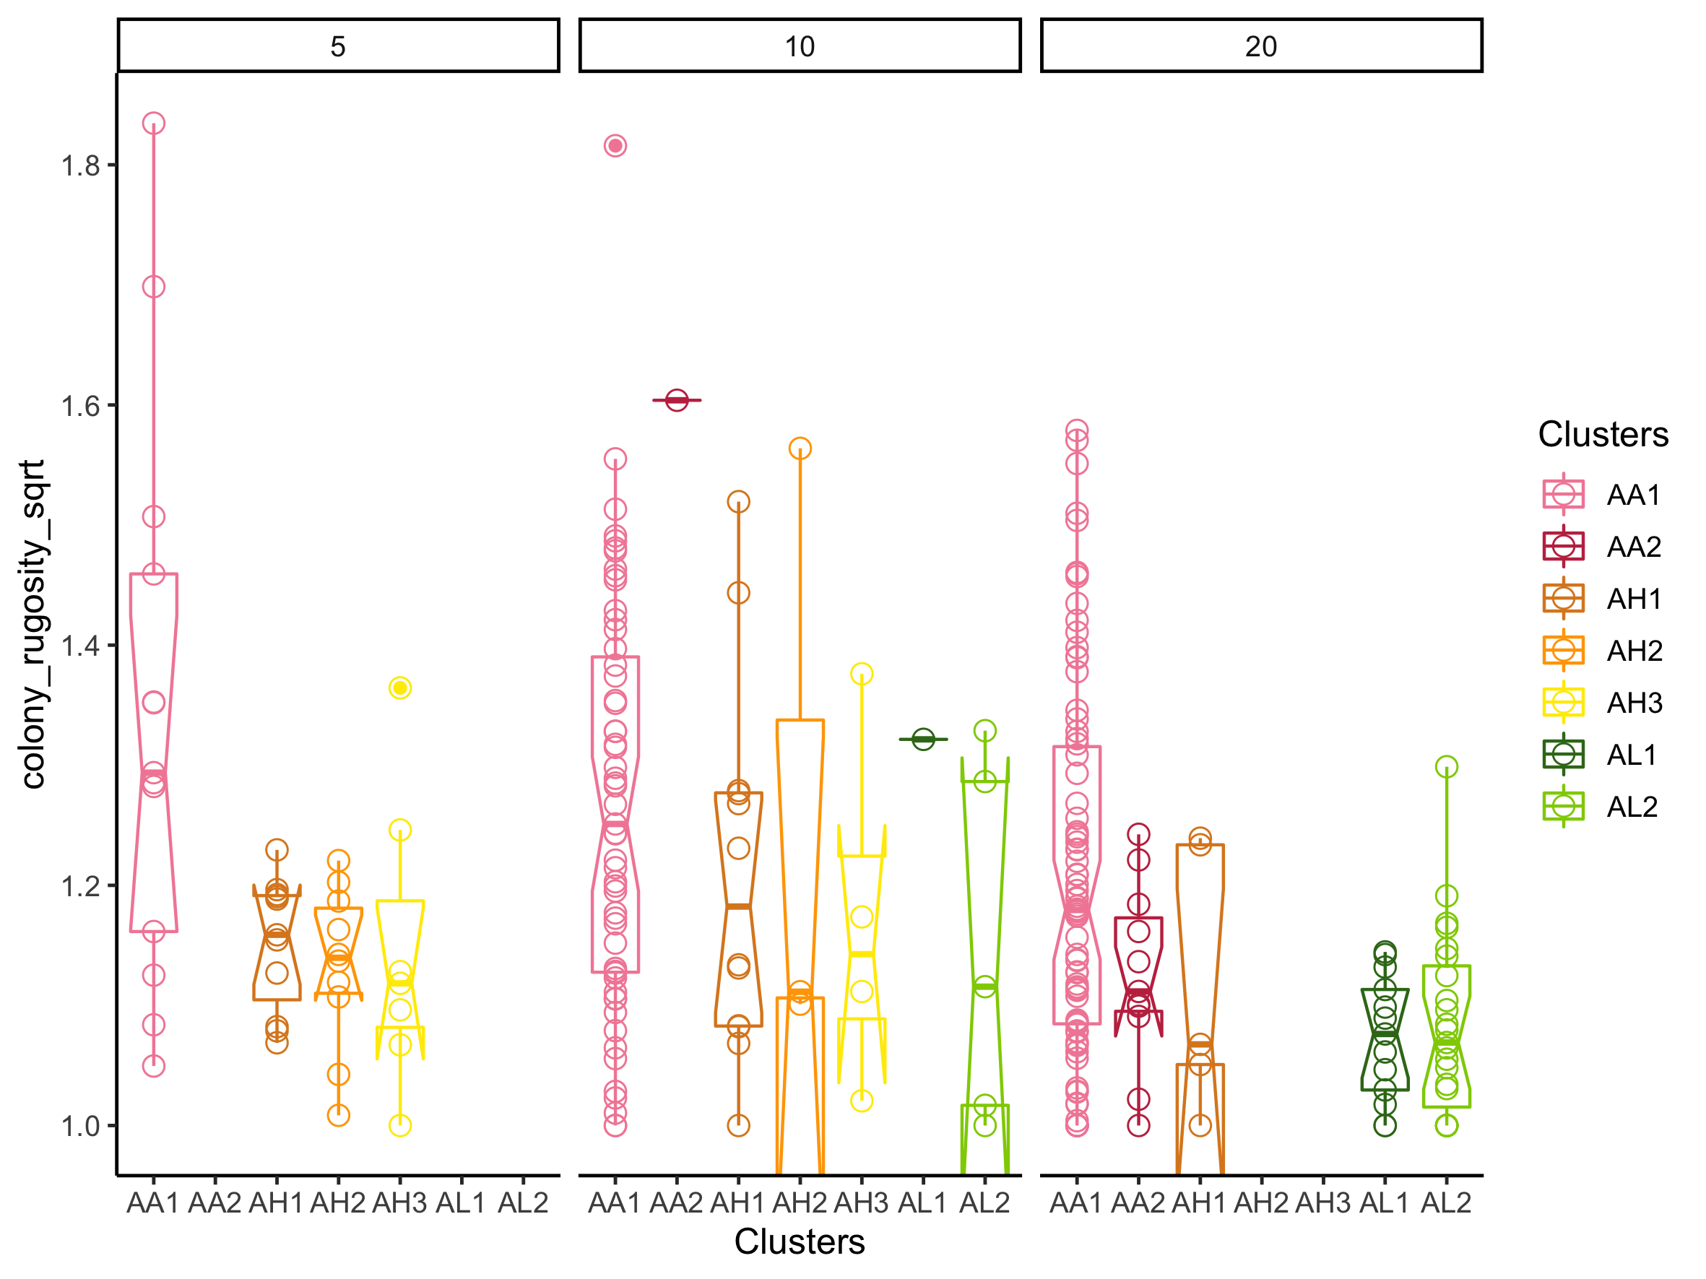

Slide 25
Stats
lm.colony_rugosity <- lm(colony_rugosity_sqrt ~ Clusters, data = metadata)
AL1-AA1 -0.150662900 -0.2779013 -0.02342448 0.0091660
AL2-AA1 -0.146911992 -0.2407368 -0.05308714 0.0001074

Slide 26
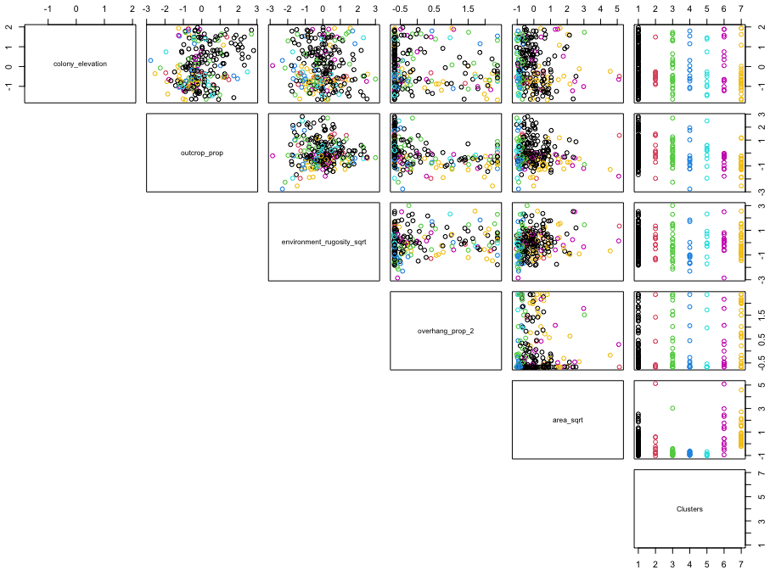

Slide 27
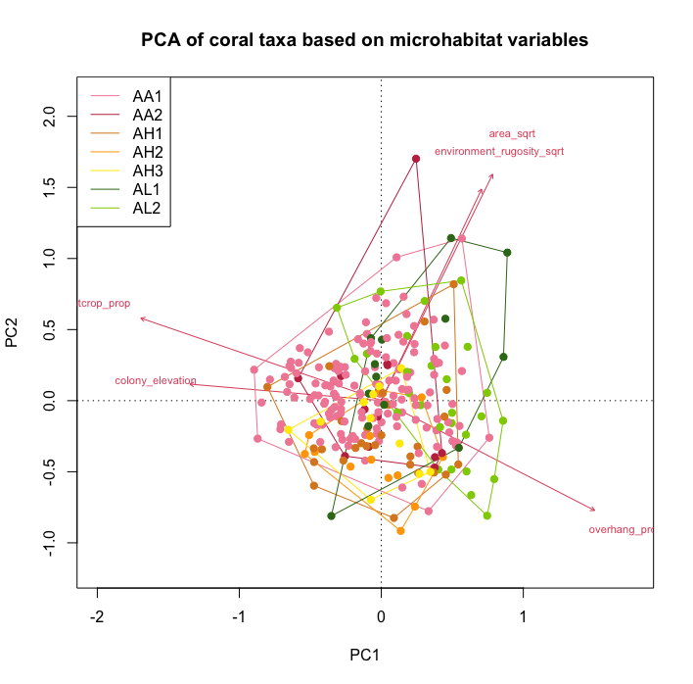

Slide 28
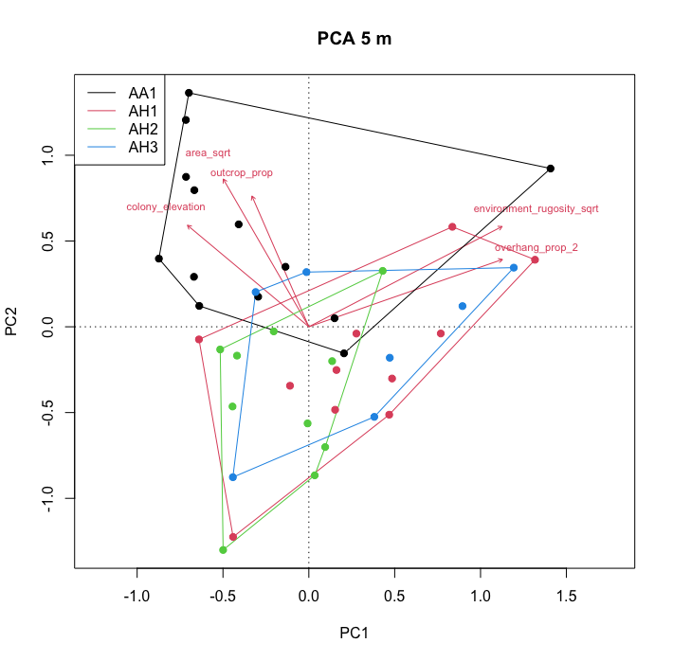
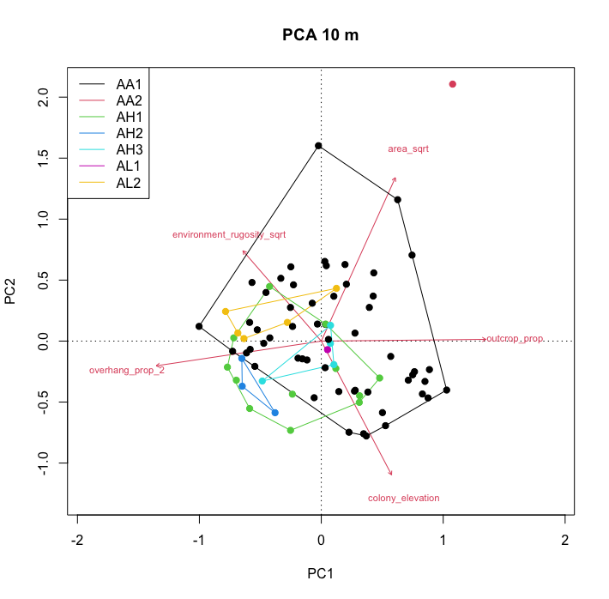
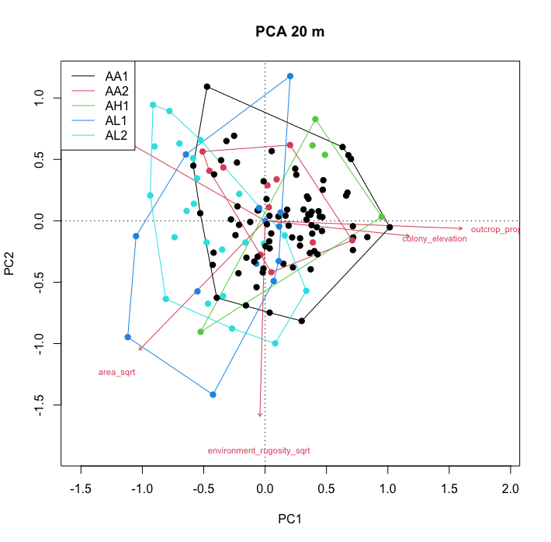

Slide 29
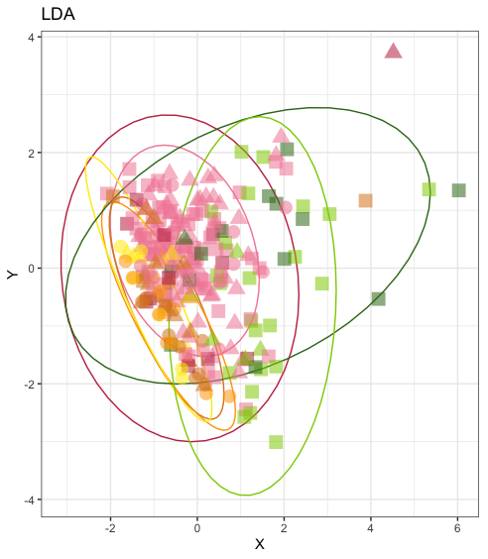
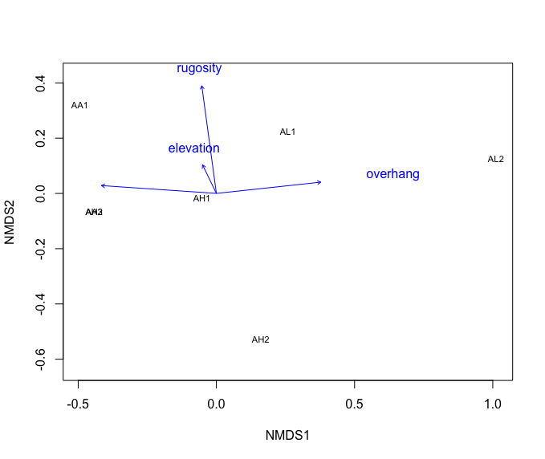

Slide 30
Area – does size matter?

Slide 31
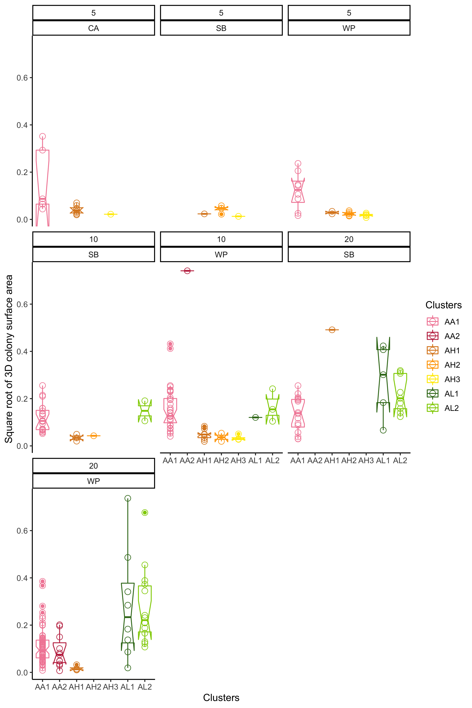
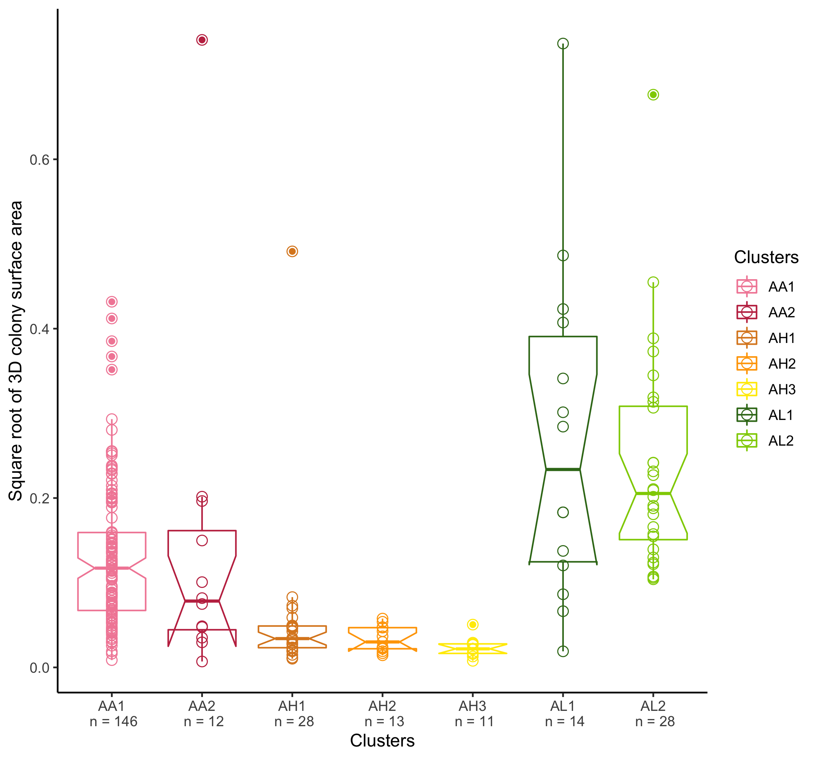

Slide 32
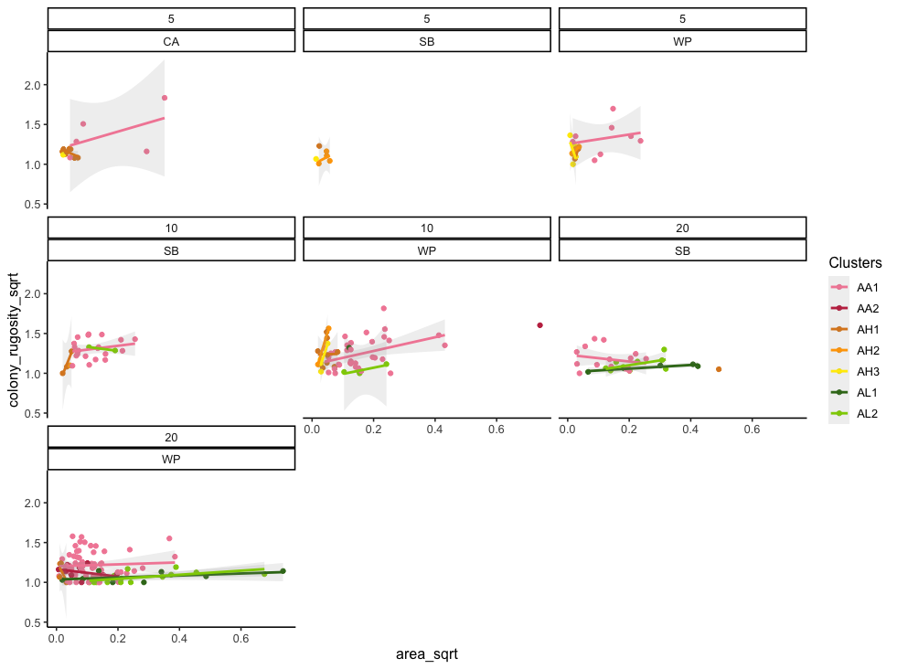
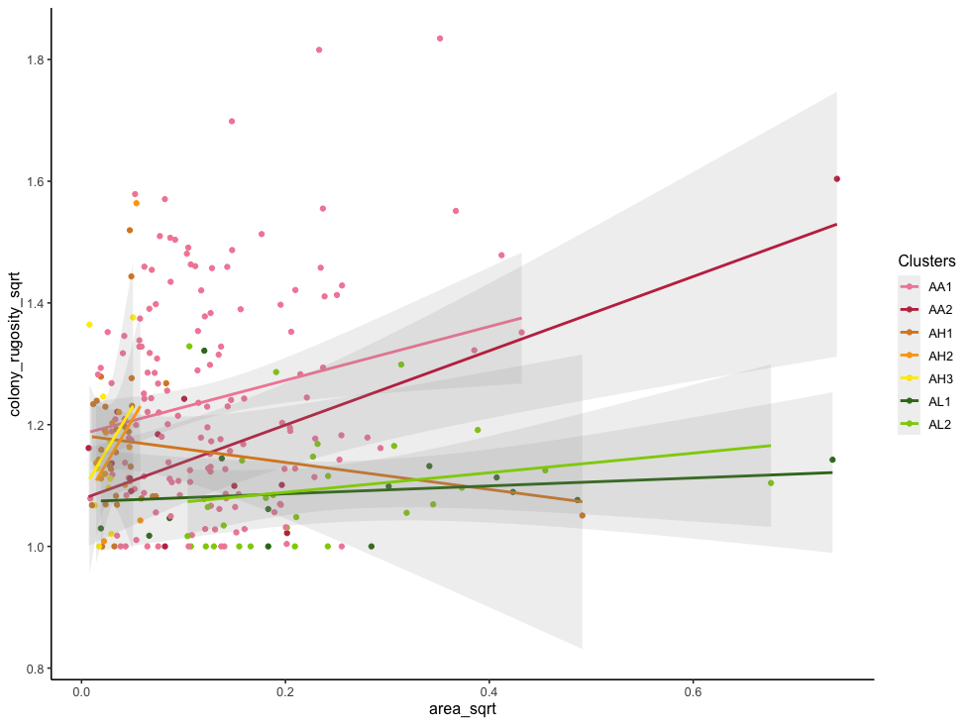

Slide 33
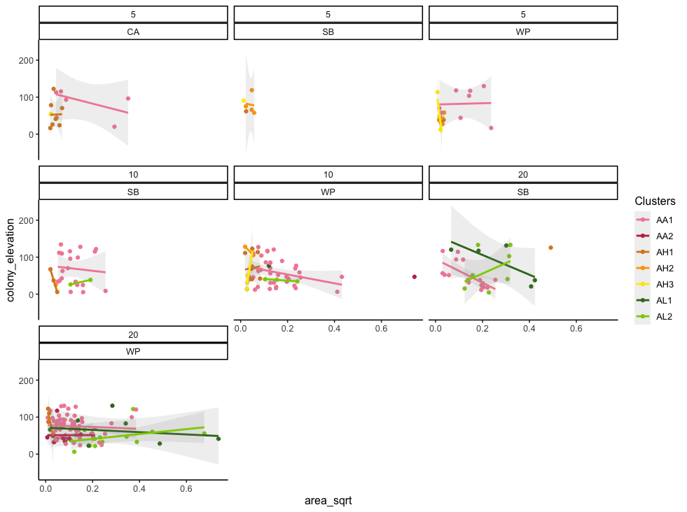
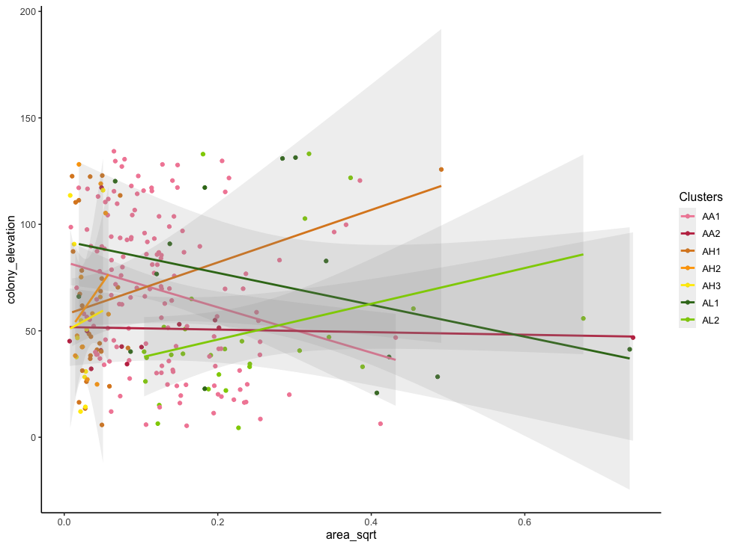

Slide 34
Disentangling colony elevation vs. overhang….

Slide 35
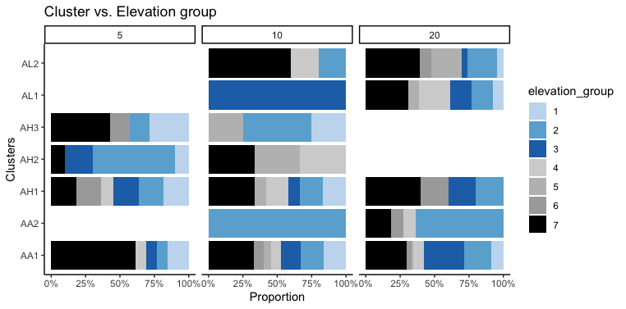
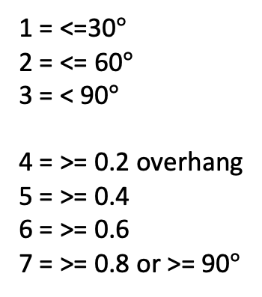
1 = <=30$°$
2 = <= 60$°$
3 = < 90$°$
4 = >= 0.2 overhang
5 = >= 0.4
6 = >= 0.6
7 = >= 0.8 or >= 90$°$

